Slide 1
CAPSTONE PROJECT-2 on NETFLIX MOVIES AND TV SHOWS CLUSTERING
BY
AESHU AGARWAL

Slide 2
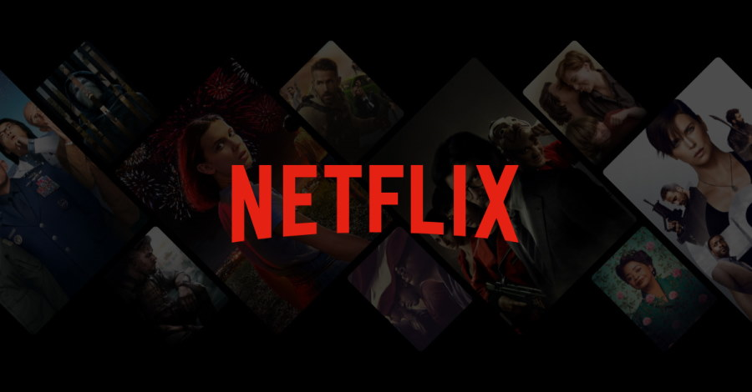
CONTENTS
Introduction
Problem Statement
Data Description
Null Value
Exploratory Data Analysis
Data Cleaning
Topic modelling
Model Implementation
K-means
Cluster Analysis

Slide 3
Problem Statement
This dataset consists of tv shows and movies available on Netflix as of 2019. The dataset is collected from flexible which is a third-party Netflix search engine.
In 2018, they released on interesting report which shows that the number of tv shows an Netflix has nearly tripled since 2010.The streaming service’s number of movies has decreased by more than 2,000 tiles.
Integrating the dataset with other external dataset such as tomatoes, can also provide many interesting findings.
In this project, you are required to do
Exploratory Data Analysis
Understanding What type content is available in different countries.
Clustering similar content by matching text based features.

Slide 4
Data Description
The data was collected from flexible which is third party netflix search engine. The dataset consists of movies and tv shows data till 2019.
The dataset consists of eleven textual columns and one numeric column.
Attribute Information:
show_id : unique ID for every movie
type : identifier a movie or tv shows
title: title of the movie’
Director: director of the movie
Cast: actors involved in the movie
Country: country where the movie was produced
Duration: total duration

Slide 5
Null Value
Null Value Treatment
Director feature have more than of null values, fillings null value by unknown.
Country feature have 6.51% of null values. Filling out of null values.
Cast feature have 9.22% of null values.
Rating out of null values .

Slide 6
THANKING YOU

